Slide 1
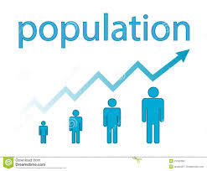
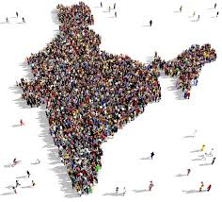
NAAN MUDHALVAN PROJECT
TRACING THE GROWTH OF GLOBAL COMMUNITY :A POPULATION FORECASTING ANALYSIS

Slide 2
TEAM HEAD: K.Muthu Kavitha TEAM MEMBERS: 1. K.Muthumala 2. B.Nandhini 3. B.Nithyarubini We, a team of 4 students are from III B.Sc. Mathematics , A.K.D.Dharmaraja Women’s College, Rajapalayam.

Slide 3
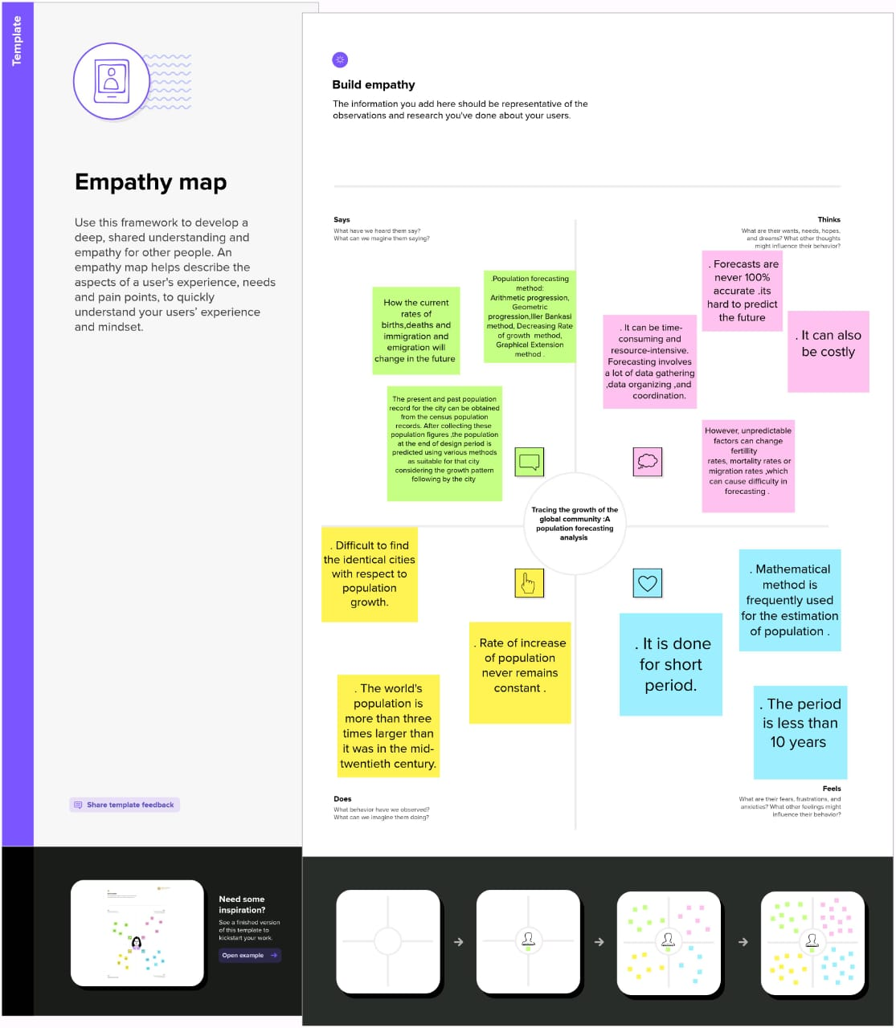
EMPATHY MAP

Slide 4
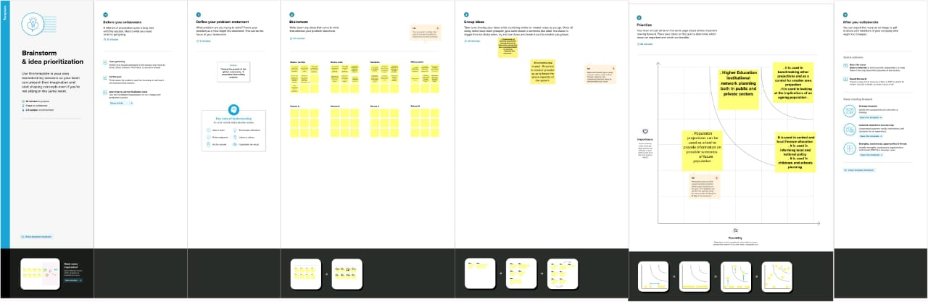
BRAINSTORMING

Slide 5
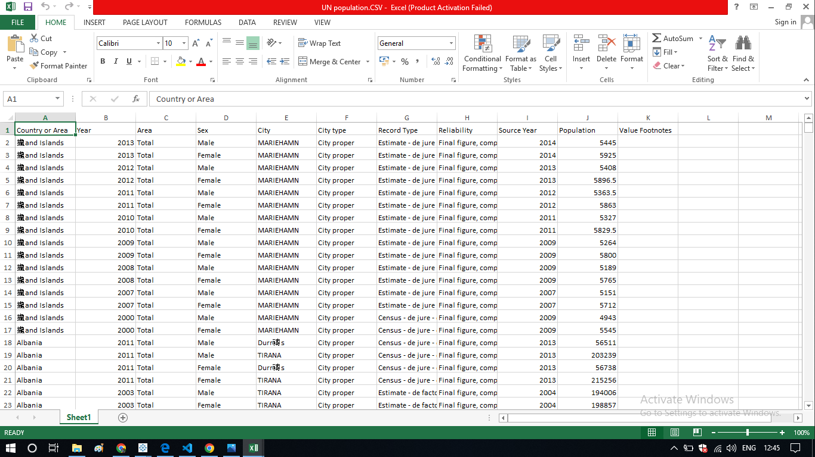
ANALYSING DATA

Slide 6
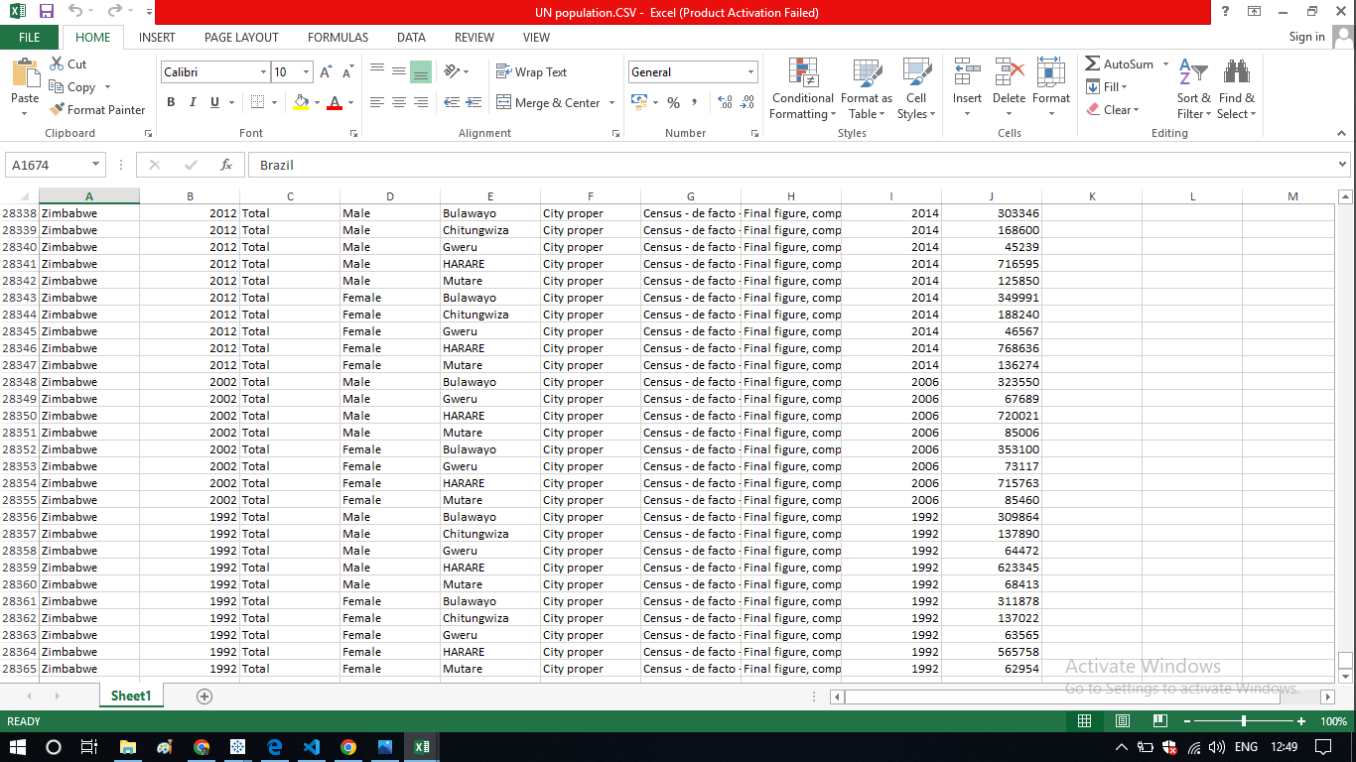

Slide 7
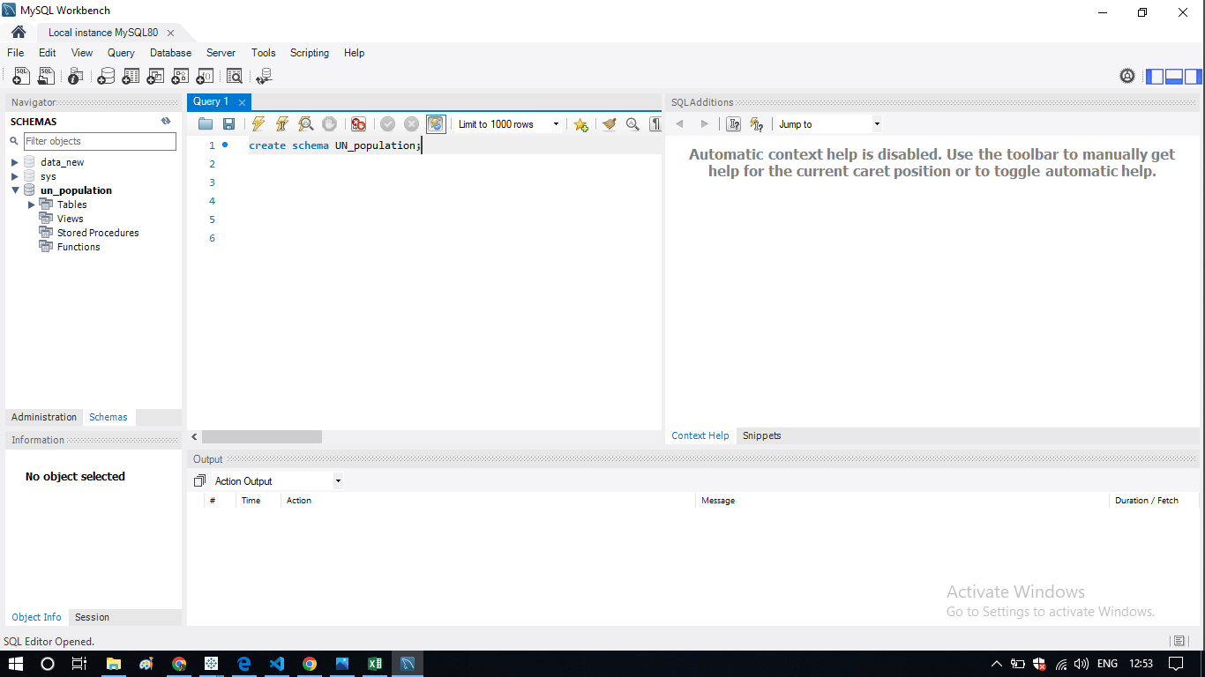
MTSQL WORKBENCH

Slide 8
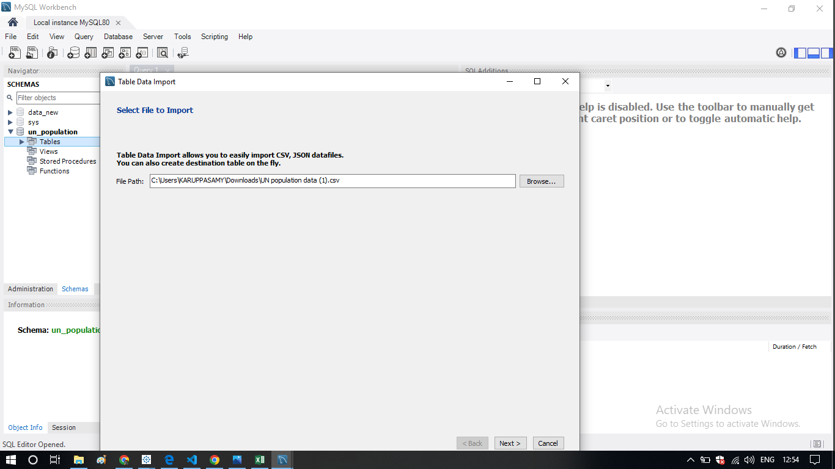

Slide 9
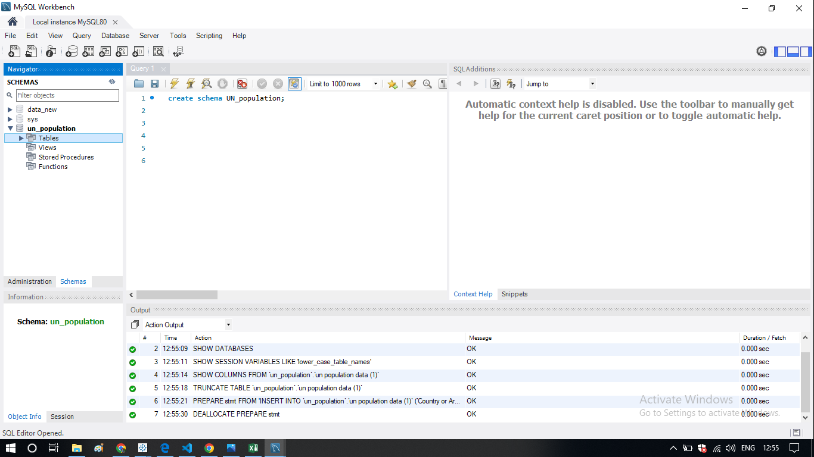

Slide 10
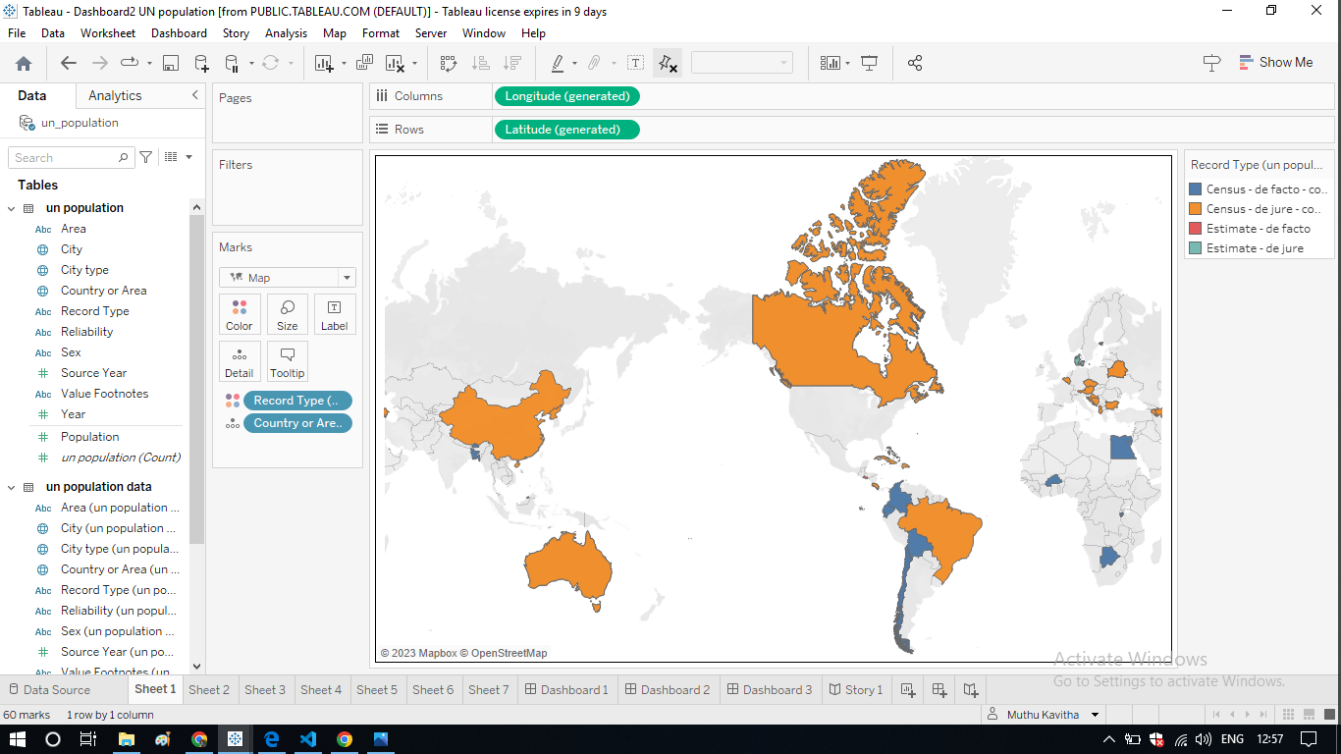
POPULATION RECORDS BY TYPE OF COUNTRIES:

Slide 11
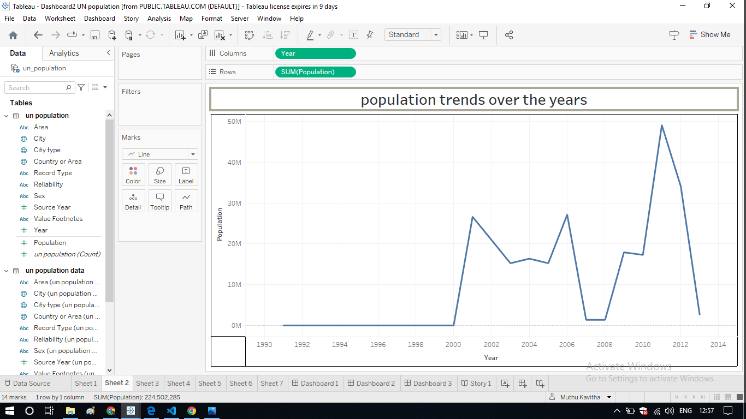
POPULATION TRENDS OVER THE YEARS

Slide 12
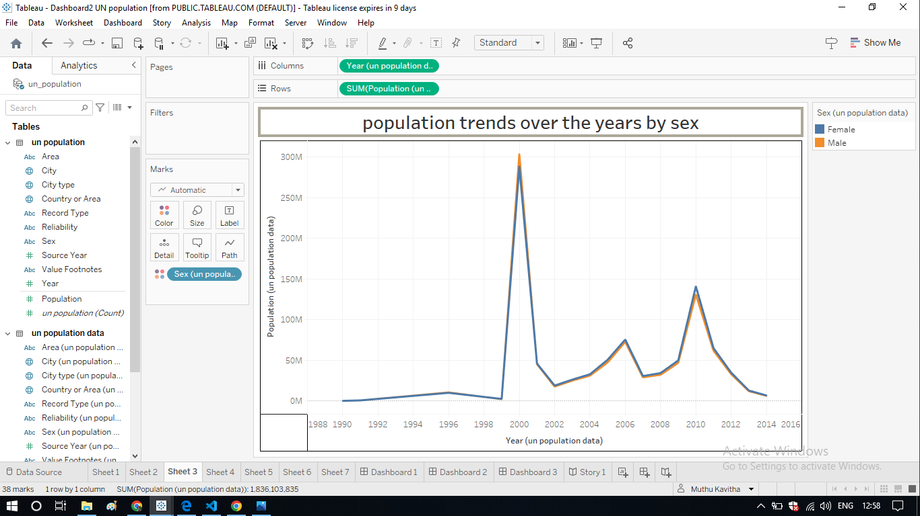
POPULATION TRENDS OVER THE YEARS BY SEX

Slide 13
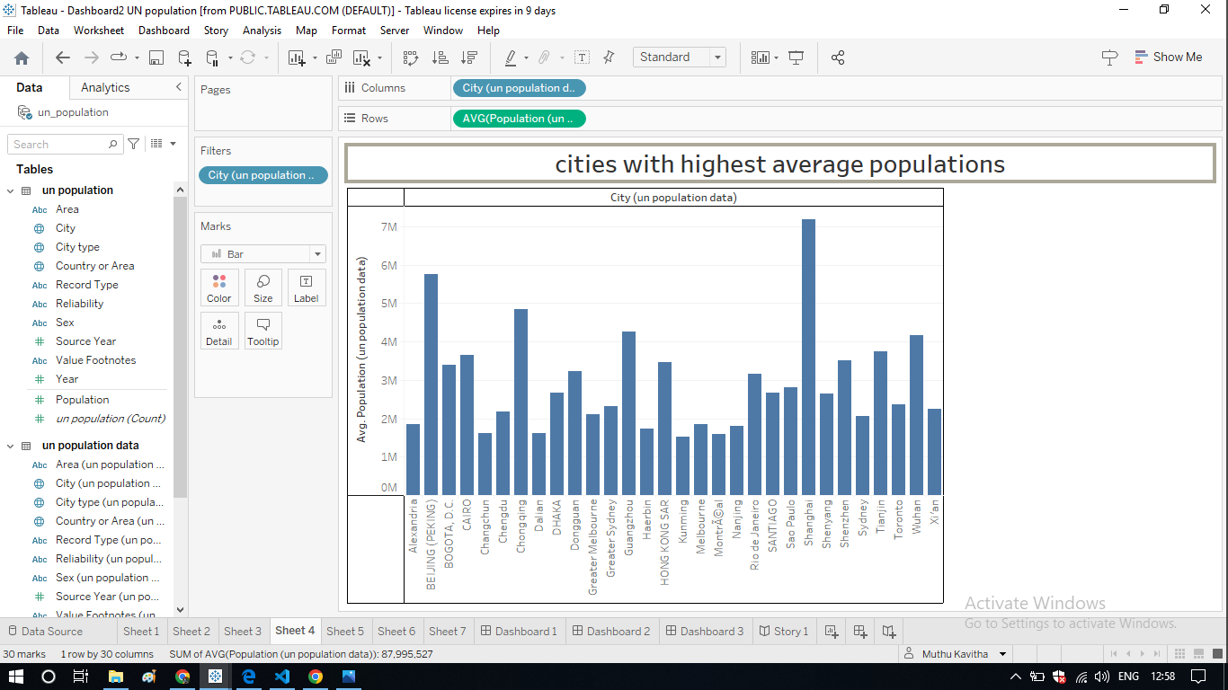
CITIES WITH HIGHEST AVERAGE POPULATIONS

Slide 14
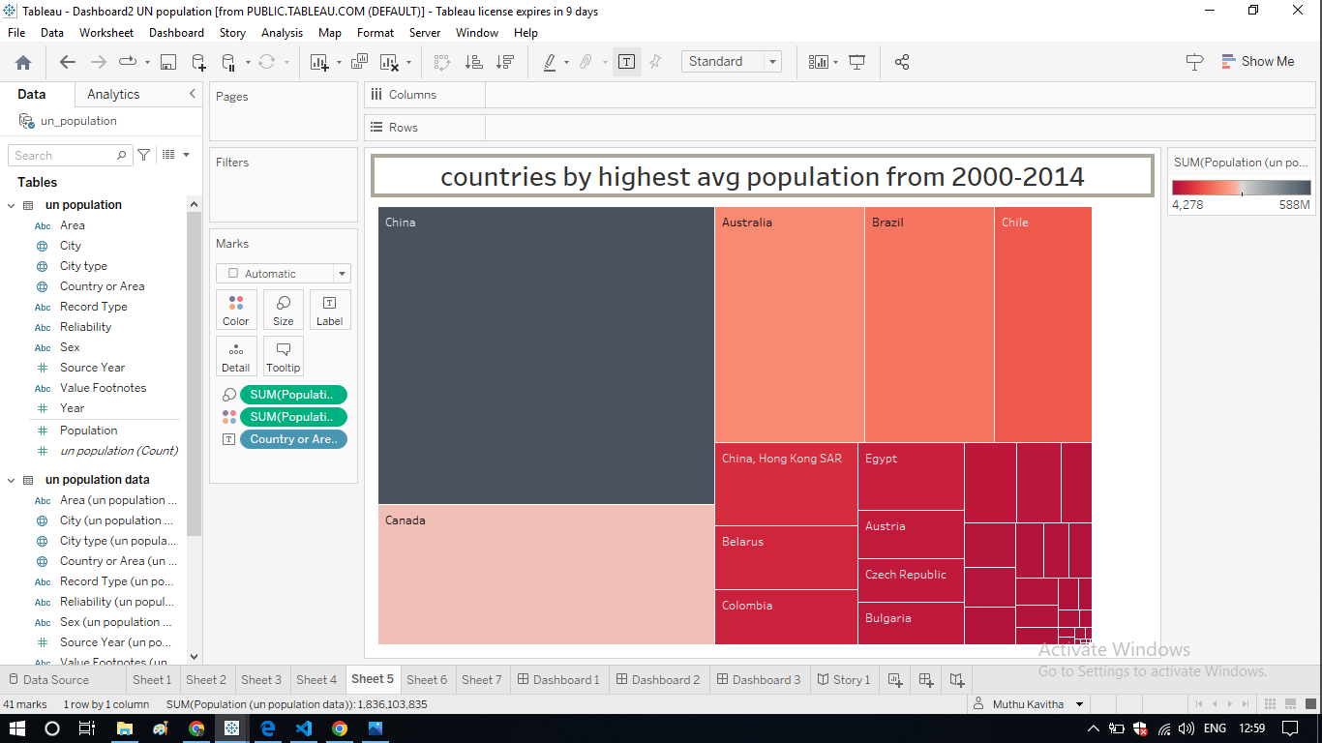
COUNTRIES BY HIGHEST AVERAGE POPULTION FROM 2000-2014

Slide 15
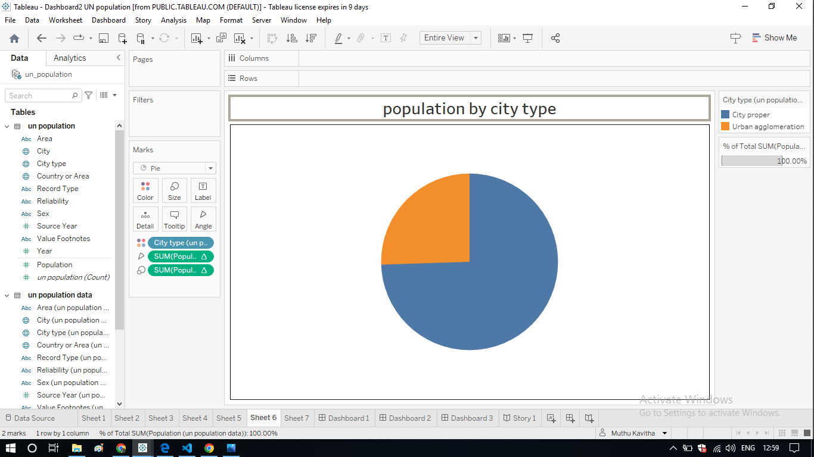
POPULATION BY CITY TYPE

Slide 16
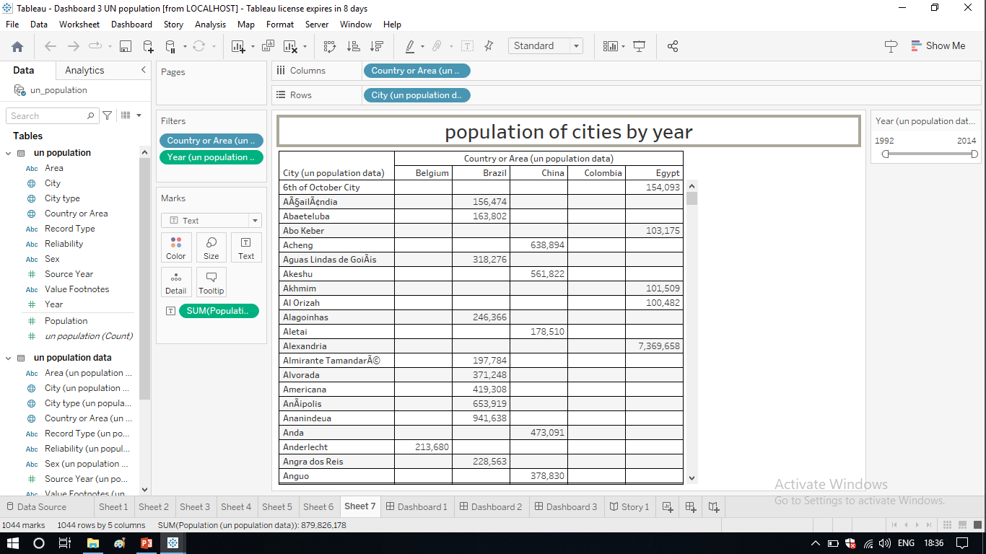
POPULATION OF CITIES BY YEAR

Slide 17
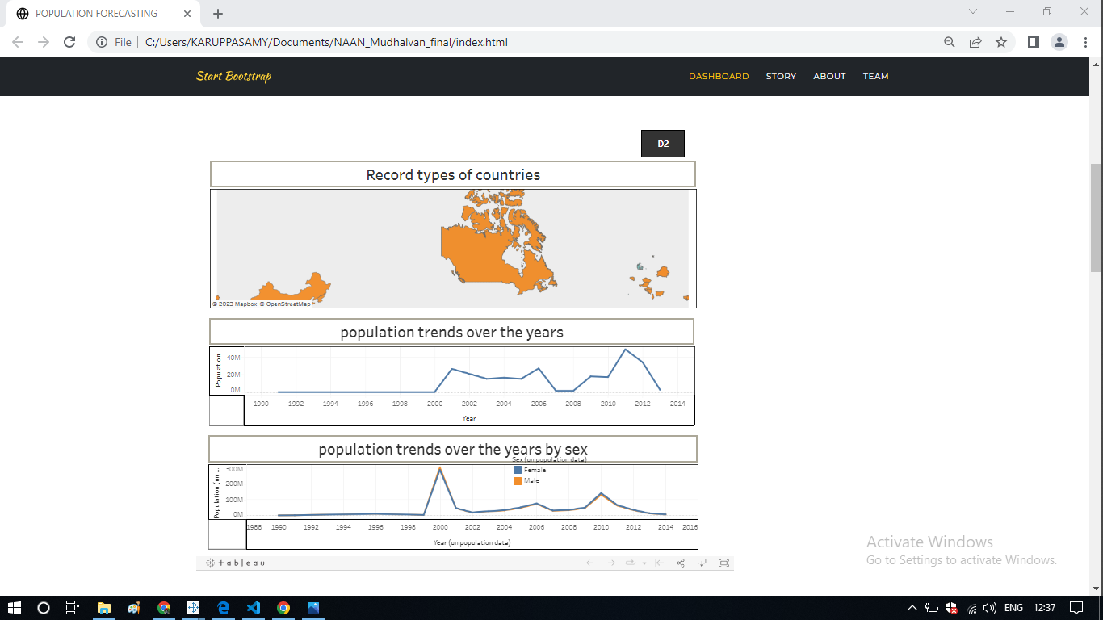
DASHBOARD:

Slide 18
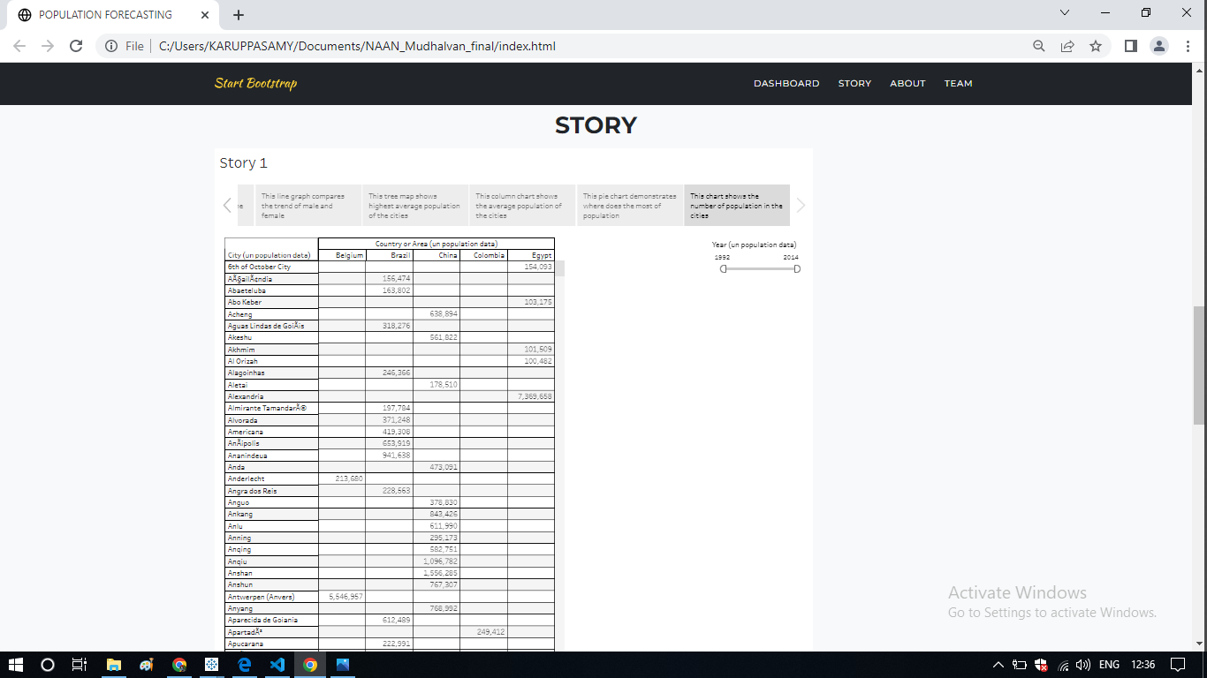
STORY:

Slide 19
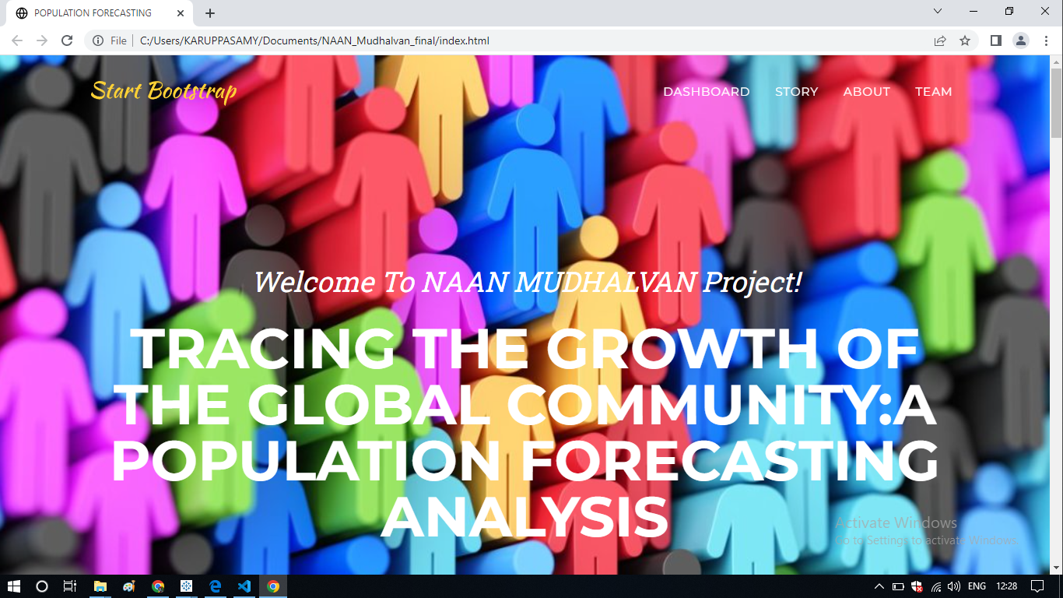
FINAL OUTPUT:

Slide 20
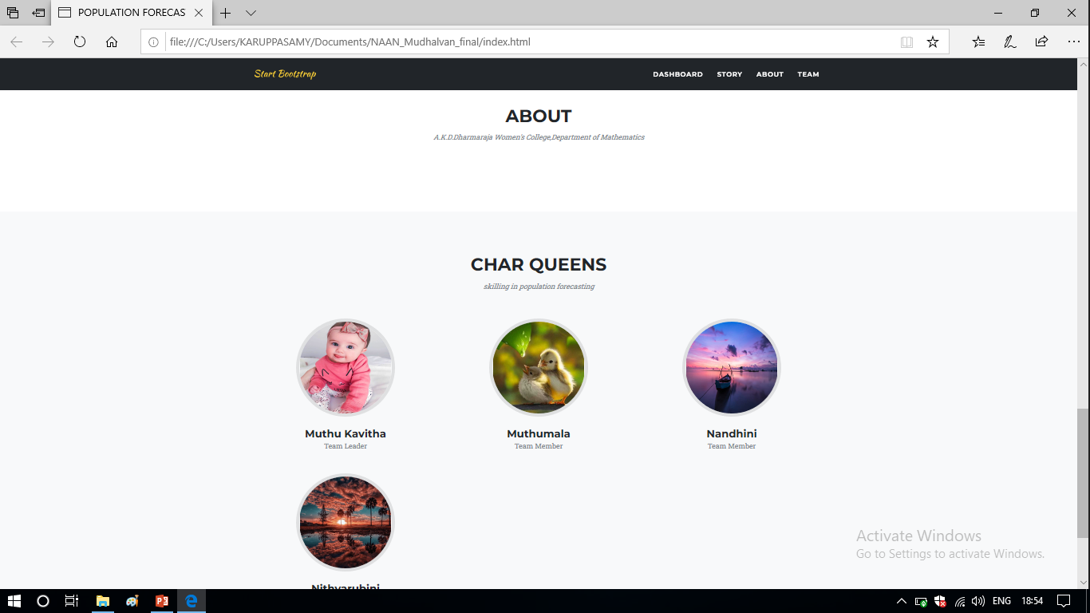

Slide 21
THANK YOU

